Slide 1
Evacuation from Europe
Early 1600’s (17th Century)
Identify and explain the political, social, economic, sanitary, moral and Religious conditions which existed in 1600’s England, that persuaded many people to immigrate to America?

Slide 2
Pre Test
In what time period did the following countries colonizing America?
Spain
England
France
What is the primary difference between Feudalism and Capitalism?
Why were a lot of British, French and German citizens moving from the countryside, in their home countries, to the cities during this time period?

Slide 3
PT…Continued
What is the Columbian Exchange? How did it lead to a population explosion in Europe?
Cats, Dogs and superstition in Europe—how do they relate to this time period?
What are the main reasons people left Europe for America in the 17th and 18th Century?
Why did the Pilgrim man’s pants always fall down?

Slide 4
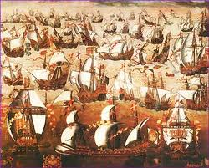
Political Background
England becomes the worlds strongest sea power in 1586…why?
Defeat of the Spanish Armada!!
So what??

Slide 5
Economic Problems
Lack of economic opportunity for the common person. Why??
Europe is going through a dysfunctional & painful transition from FEUDALISM to Capitalism!

Slide 6
Economic Problems..continued
What is Feudalism?
9th-15th Century
Economic system which is based on title and land ownership.
“Quid Pro Quo”

Slide 7
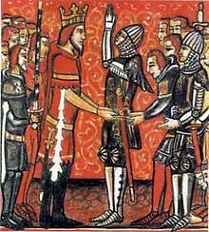

Slide 8
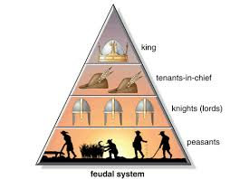

Slide 9
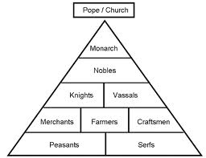

Slide 10
Economic Problems..continued
What is Capitalism?
A more inclusive economic system which is based on:
land ownership
Production of products
Buying and selling labor

Slide 11
The transition from Feudalism to Capitalism led to remarkable change!
Demographic Movement
Urbanization
Break down in social structure & relationships……

Slide 12
Why did people leave?
Population Explosion
Columbian Exchange (p. 15)
Potato…Corn…..
Malnutrition
Still, the diet is primarily Bread and Cheese
Disease
Rickets, diphtheria, typhoid, TB, small pox and…………..

Slide 13
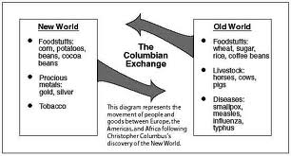

Slide 14
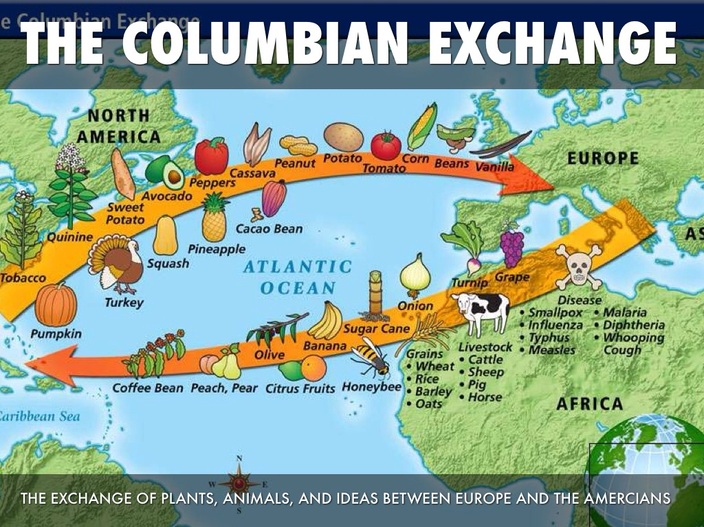

Slide 15
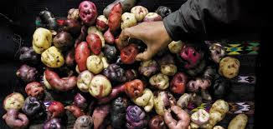
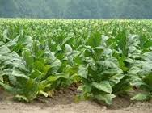
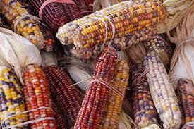

Slide 16
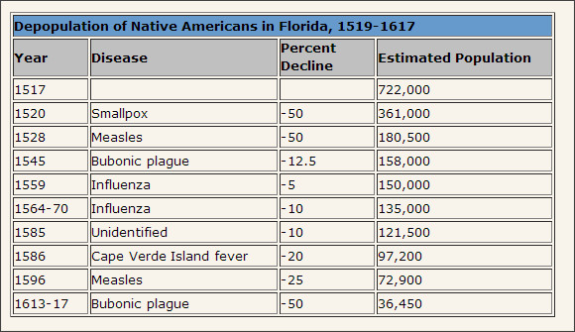
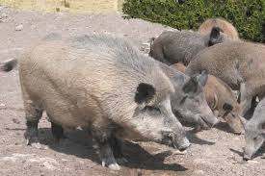
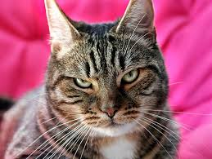
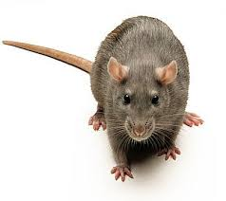

Slide 17
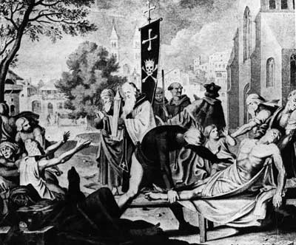
THE BLACK DEATH (PLAGUE)
Sanitation
Superstition

Slide 18
What has this to do with anything?

Slide 19
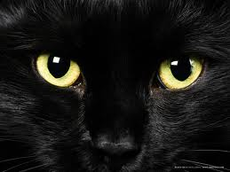
The Domestic Cat---Designed to Kill Rodents yet superstition prevented people from owning them!

Slide 20
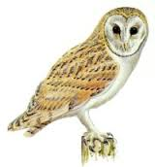
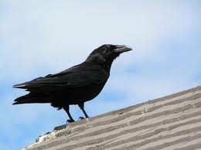
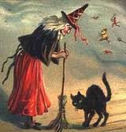
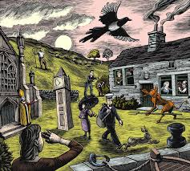

Slide 21
Well I guess you could use dogs! The Rat Terrier---Cute, But Designed to be a KILLER!

Slide 22
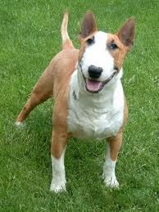
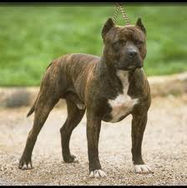
The English Bull Terrier and its Unpredictable Cousin, the American Pit Bull

Slide 23
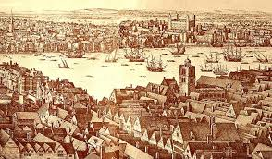
London—1600 AD. Big and Nasty.

Slide 24
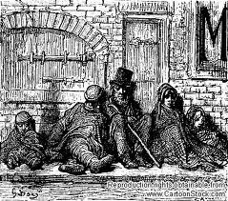
Europe’s Population Explosion led to a Shortage of Housing

Slide 25
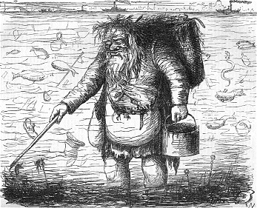
British Cartoon Addressing the Filth of the Thames River—circa 1600

Slide 26
Break down of Values and Social Control!
Violence & Theft
Dysfunctional law enforcement
Dysfunctional judicial system
Immorality
Alcoholism, incest…….

Slide 27
RELIGIOUS PROBLEMS…
British Theocracy = no freedom of or from Religion:
“The Church of England” or Anglicanism.
Ministers who owned pubs!
Drunkenness and riots in church!
Ministers with illegitimate children

Slide 28
RELIGIOUS PROBLEMS
These Conditions Lead some groups to protest!
The government makes them “an offer they cannot refuse……..”
The Puritans, Pilgrims, Quakers

Slide 29
Promotion of the New World
America is Resource Rich but Labor Poor
America is Resource Rich but Labor Poor
America is Resource Rich but Labor Poor
America is Resource Rich but Labor Poor
America is Resource Rich but Labor Poor
America is Resource Rich but Labor Poor
America is Resource Rich but Labor Poor

Slide 30
SO WHAT?
What are the implications of the fact that America was Resource Rich but Labor Poor?
A massive advertizing campaign is established to advertize America!
Spirits
Use truth, half truths, lies, deception, drugs to “encourage” people to go to America!

Slide 31
British immigration 1620-1642
80,000 British Citizens will Immigrate to America!
Why?

Slide 32
Significance of the Evacuation
Columbian Exchange
Technology
Change in economy
Religion…”of or from”
Basic human needs

Slide 33
Quiz….
*You may work with a buddy
*Create a Poem or Rap which illustrates the conditions which led many people to immigrate to America in the 1600 and 1700’s.
*10-20 lines.

