Slide 1
Tremendous Tuesday!
Who needs heat??
Wednesday-Monday option…..
Lets think Geography, shall we…
You get to create a North American Map which features…………

Slide 2
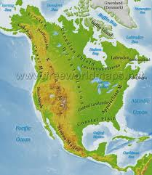
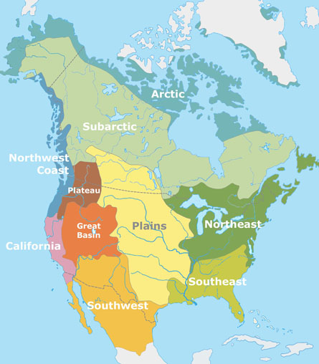
PHYSICAL GEOGRAPHY & NORTH AMERICAN INDIAN CULTURE AREAS!

Slide 3
Please label your map with:
Indicated Topographical terms
See handouts
North American Indian Traditional Culture Areas.
And………

Slide 4
MORE STUFF……
Make sure your map includes:
The Arctic through Mexico
Atlantic to the Pacific
Compass rose
You may write features on map or use a key!
Label North American Indian culture areas and historically dominant tribes

Slide 5
And last but not least
It should be beautiful!

