Slide 1
Native American Culture Areas and Major Climates of the USA
See the next two slides.

Slide 2
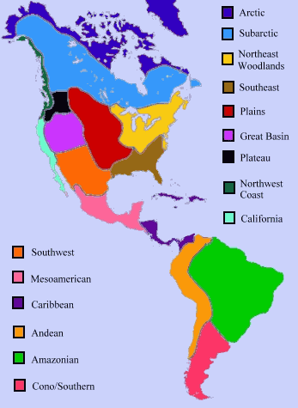

Slide 3
