Slide 1
Colonial Story!
Create an outstanding Historical-Fiction story based upon the character you are researching.
Historical Fiction implies an accurate description of historical conditions which are artfully illustrated in a story.

Slide 2
Story requirements
If you work alone—At least 2 pages written or 1 page typed (single space, 12 font)
If you work with a partner—4 pages written or 2 pages typed (single space, 12 font)
The story can be historical fiction or allegorical.
Due Date: TBA

Slide 3
#1: Persecuted Christian
Not free to worship in England!
Either Convert, go to Jail, go meet your maker or go to America!
Here comes the Puritans, watch out Witches!

Slide 4
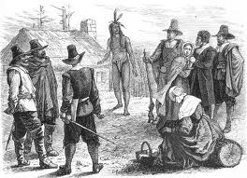
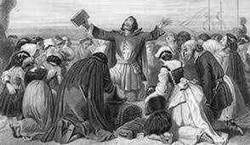
PURITANS & PILGRIMS!

Slide 5
#2 : English Prison Inmate
Your Choice: Go to America as an Indentured Servant, or remain in some of the most dangerous prisons in the world!

Slide 6
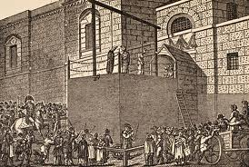
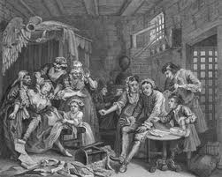
DEBTOR PRISON INMATES
ENGLAND WAS FAMOUS FOR CRUEL PRISONS

Slide 7
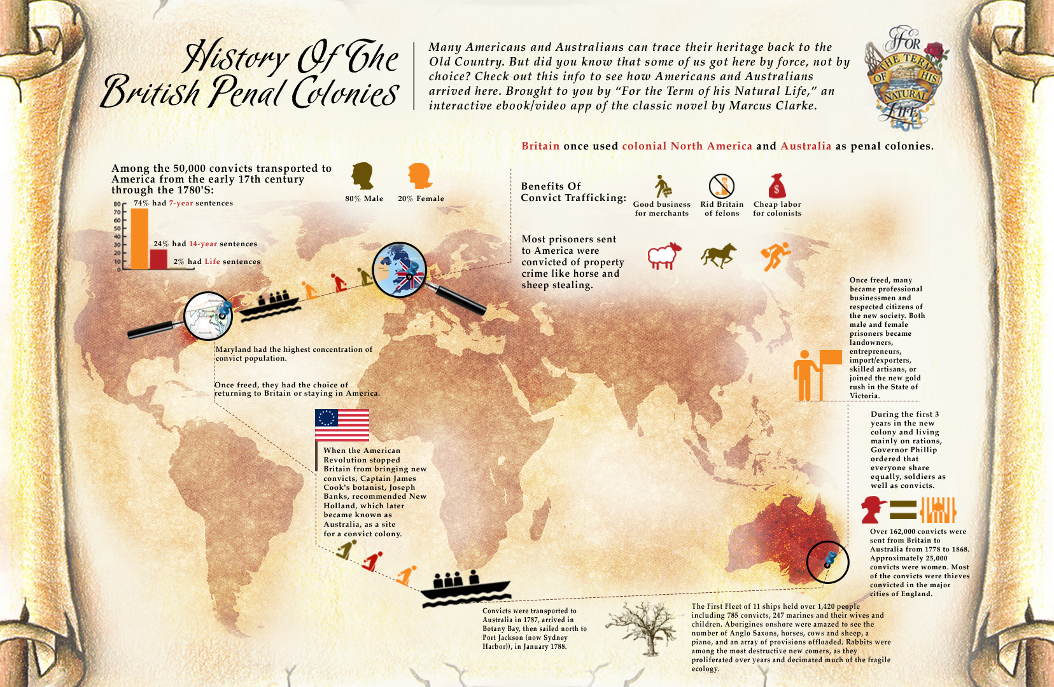
A SAD HISTORY:

Slide 8
#3: I want to go, but I cant afford it ☹
Hey, its your lucky day! If you sign on the dotted line I will give you a free trip to America!!*
Sign here______________ (an XXX is ok)
*In exchange for 7 years hard labor. At the end of the defined period of indenture, if the servant performs duties, as defined by master, the servant will receive payment insofar as applicable to conditions defined in the Indenture contract that you signed when you were 3 sheets to the wind. Sorry. Well not really.

Slide 9
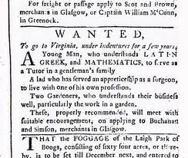
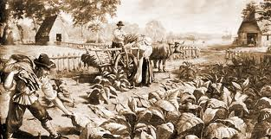
Indentured Servants—5-7 years of hard labor & the promise of a new life!

Slide 10
*The Fine Print….
*In exchange for 5-7 years hard labor. At the end of the defined period of indenture, if the servant performs duties, as defined by master, the servant will receive payment insofar as applicable to conditions defined in the Indenture contract that you signed when you were 3 sheets to the wind. Sorry…. Well not really. Hey! Get to work!!

Slide 11
#4: NOBLE
Hey you got it all! Riches, great seats to the Opera….but do you want more? Land is cheap in America, Tobacco is very profitable. In America there is unlimited economic potential (1000% return on investment!)* You might even get appointed Governor!
*Well sometimes people lose their _ss.

Slide 12
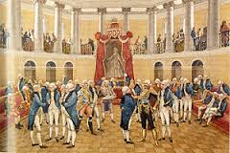
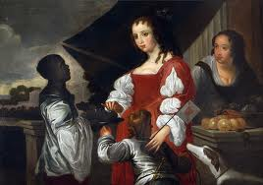
British Nobility had the resources to cash in on Tobacco, Sugar Cane and Cotton!

Slide 13
The fine print……
*Well sometimes people lose it all and die of starvation (see Jamestown!)

Slide 14
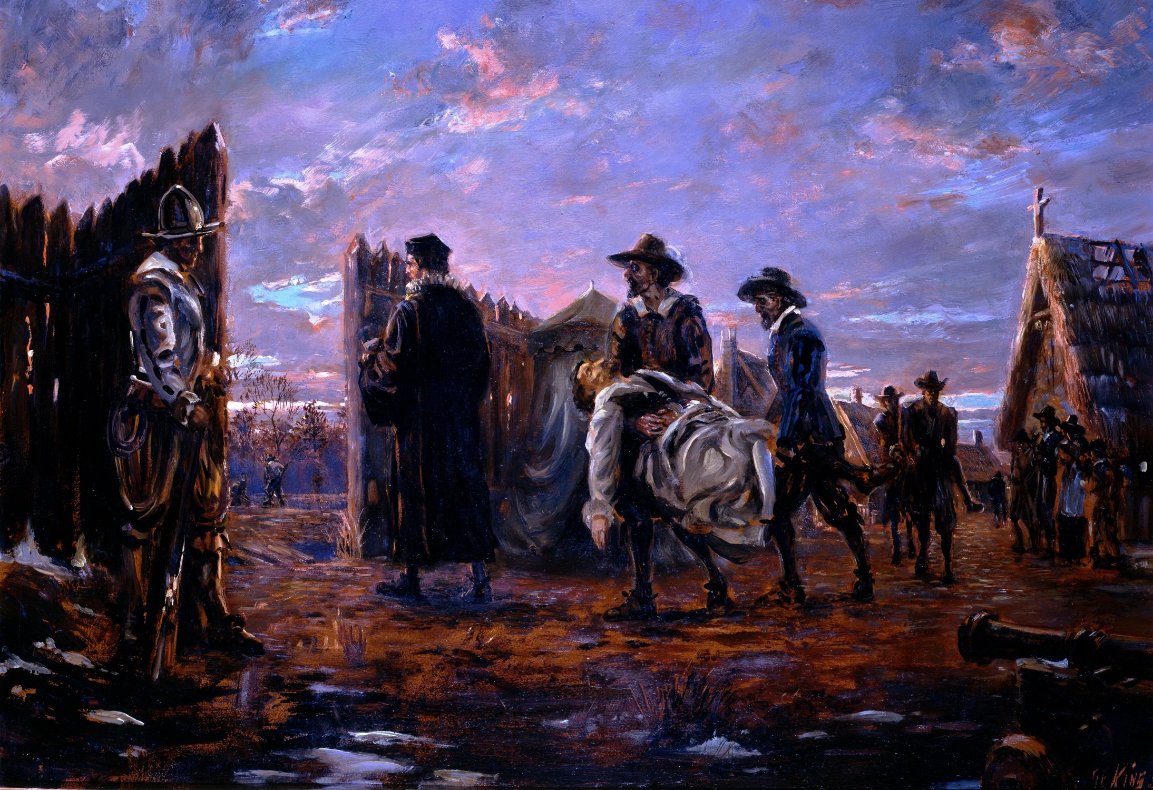
“The Starving Time” Leads Some Colonists to Resort to Cannibalism!

Slide 15
#5: Boat Captain
Hey you-- swab the deck, say your prayers, climb the lines..we got cargo. I'm fixin to make plenty o’ pounds in the new world… tobacco, molasses, rum…hummmm …where do I get a crew?

Slide 16
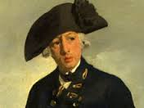
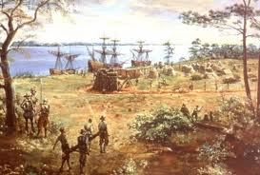
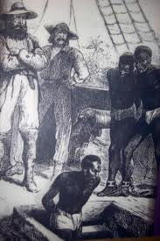
Boat Captains transported anything…Tobacco, Cotton, Rum and sadly Slaves

Slide 17
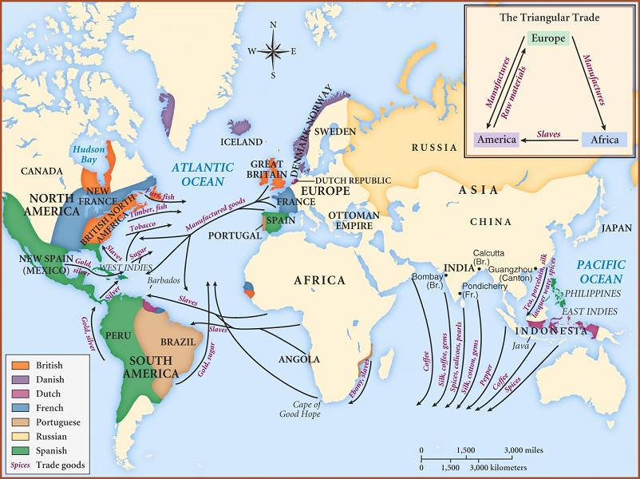

Slide 18
#6: Merchant
Buy, buy, buy…sell, sell, sell! Those Colonists are gonna need supplies! Those Europeans are gonna want stuff from America! I bet we could even trade with the Indians!!

Slide 19
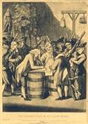

Slide 20
#7: Dutch & German
I am educated
I have some Marks
I am an outstanding farmer
We are running out of farm land in Germany
We Dutch are the best merchants in the world
America? Humm

Slide 21
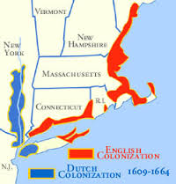
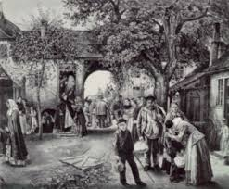
THE DUTCH AND GERMANS WERE DRAWN TO THE MIDDLE COLONIES!

Slide 22
#8: Frenchman
I hate the British
The Germans are a bore
The Spanish…please so uncivilized
Fur trading in the North you say? A very lucrative trade….
I could make a lot of francs!

Slide 23
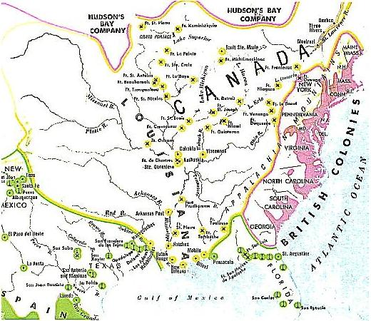
NEW FRANCE!

Slide 24
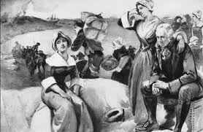
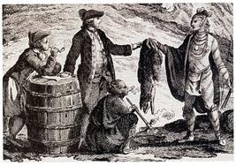
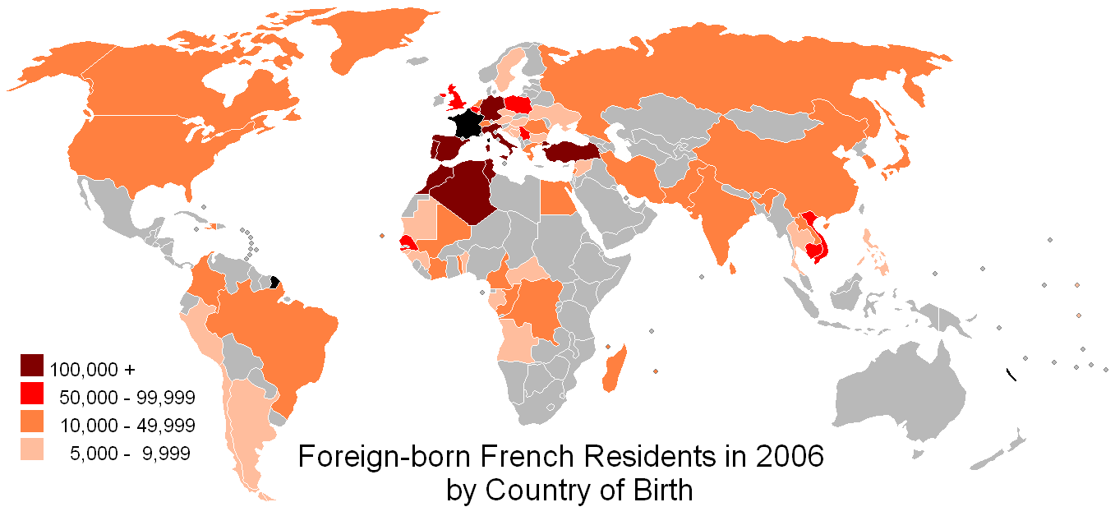
The French are Everywhere!

Slide 25
#9: Poor Englishman/Irish/Scotch-Irish
Life in the city is unbearable…crime, disease, fire, raw sewage, alcoholism…dysfunction everywhere. We have a bit of money—maybe we should take a leap of faith to America?

Slide 26
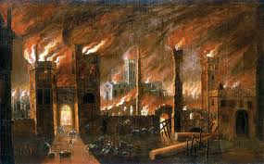
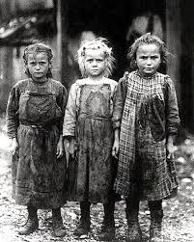
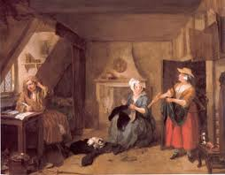
Poor housing, orphans, fire. “hey lets go to Merica!”

Slide 27
#10: Pirate
Capin Jack & Capin Morgan say the bloody British Government gave him the O.K. to Pirate in the name of the King! Imagine that, Only rule is to attack the Spanish & French. Well, maybe crime does pay!

Slide 28
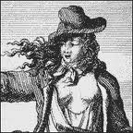
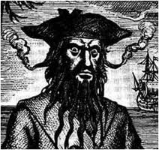
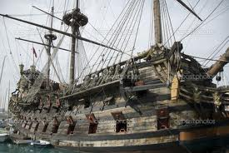
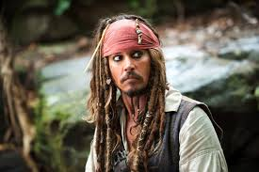
ANNE BONNY
BLACK BEARD AND JACK
Jack, of Course

Slide 29
11. AFRICAN
America is Resource Rich & Labor Poor which is a tremendous economic opportunity for English, Dutch and Spanish slave traders. Obviously, Africans did not want to go.

Slide 30
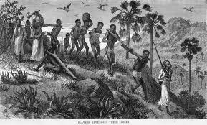
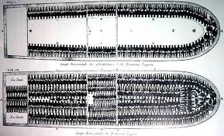
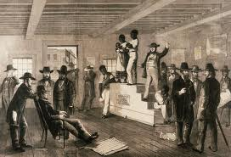
The Crime of Slavery is shared by all Americans

Slide 31
#12: North American Indian
More “weaker ones” are coming our way.
What is an Englishman without an Indian holding his hand?
The trade goods are excellent!
Should we give up more land?
We treat with them and they promise us the sun and moon
Can we trust them?

Slide 32
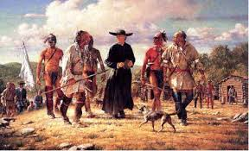
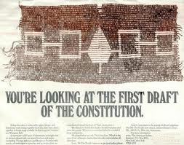
Many Tribes Freely Exchanged Culture with the Colonists. Cultural Exchange is a 2 way Street!

